Slide 1
Lecture-6

Slide 2
COMMA OPERATOR
• The comma operator in C takes two operands. It works by evaluating the first and discarding its value, and then evaluates the second and returns the value as the result of the expression. Comma separated operands when chained together are evaluated in left-to-right sequence with the right-most value yielding the result of the expression. Among all the operators, the comma operator has the lowest precedence. For example
int a=2, b=3, x=0;
x = (++a, b+=a);
Now, the value of x = 6.

Slide 3
SIZEOF OPERATOR-sizeof is a unary operator used to calculate the sizes of data types.
It can be applied to all data types.
The operator returns the size of the variable, data type or expression in bytes.
'sizeof' operator is used to determine the amount of memory space that the variable/expression/data type will take. For example, sizeof(char) returns 1, that is the size of a character data type

Slide 4
//Example of sizeof opeartor
#include <stdio.h>
int main()
{
int a;
float b;
double c;
char d;
printf("Size of int=%d bytes\n",sizeof(a));
printf("Size of float=%d bytes\n",sizeof(b));
printf("Size of double=%d bytes\n",sizeof(c));
printf("Size of char=%d byte\n",sizeof(d));
}

Slide 5
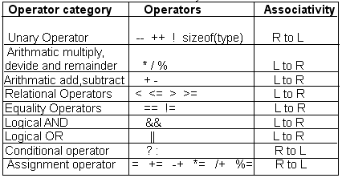
Associativity of operator

Slide 6
Example related to various operator
Program discussed:
•WAP to find sum ,difference multiplication and division of two numbers.
•WAP to find the reverse of the five digit number.
•WAP to find the sum of digit of five digit number.
•WAP to check whether the given year is leap or not.
•WAP to find area and circumference of the circle.

